Slide 1
Define: Civilization-
A complex culture with these characteristics:
Stable Food Supply
Specialized workers- artisans
Complex institutions
Record keeping- scribes (cuneiform)
Advanced technology
Art/Monument Building

Slide 2
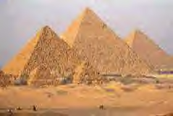
Earliest Civilizations:
1. Cities as administrative centers
2. Political system based on defined territory
3. Significant # of people in specialized,
non-food producing activities
4. Status distinctions: social classes
5. Monumental building
6. Record keeping
7. Long-distance trade
8. Major advances in science & arts

Slide 3
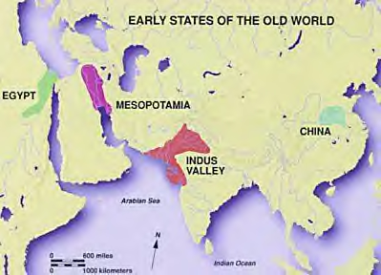

Slide 4
River Valleys
Tigris-Euphrates
Mesopotamia
Nile
Egypt
Indus/Ganges
India
Yellow
China

Slide 5
Stable Food Supply
Move to agrarian society
River valleys
irrigation/dams
floods
Trade
Barriers
Walled cities
Natural, rivers, mountains, deserts, etc...

Slide 6
Specialized Workers - Artisans
Surplus of food allowed workers to specialize
Move from farming to other jobs
Government
Religion
Trades, cobbler, blacksmith, etc...
Excess food led to greater trade and exposure to new materials and occupations

Slide 7
Complex Institutions
Religion
Polytheistic
Temples (ziggurat, pyramid, )
Priests often controlled govt.
Government

Slide 8
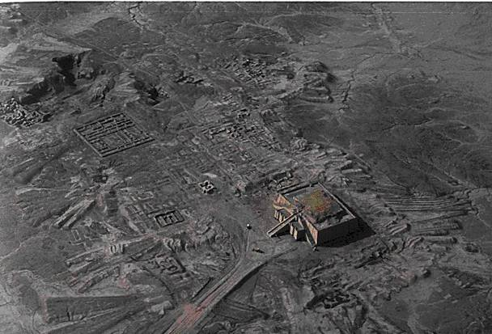
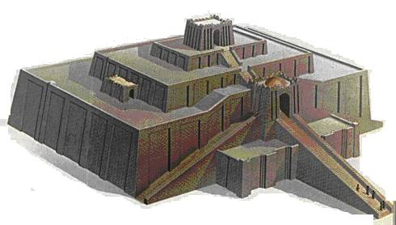
Ziggurat at Ur

Slide 9
Mesopotamian Society
4 classes
1) priests & kings
2) wealthy merchants (artisans)
3) ordinary laborers (tenant farmers, sharecroppers)
4) slaves
- captured in war
- sold to pay debts
- could earn their freedom
* women allowed most occupations & many rights
* Lack of records suggest no higher education allowed
No female scribes

Slide 10
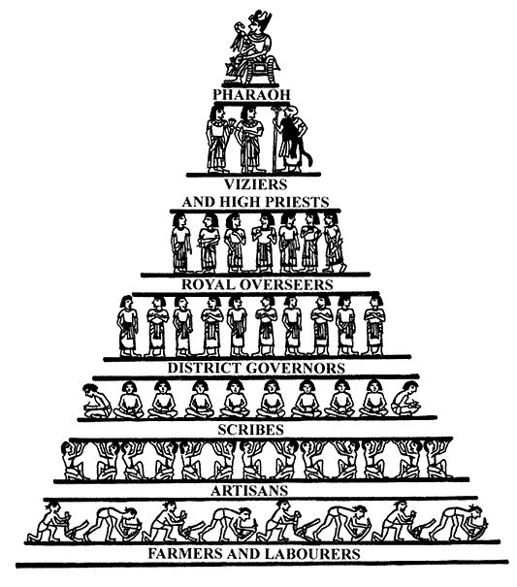
Egyptian Social Hierarchy
Kings/Queens
Upper Class
- Wealthy landowners, govt. officials, priests, army commanders
Middle Class
- Artisans, merchants
Lower Class
- Peasant farmers, unskilled laborers
Slaves

Slide 11
Egyptian Nobility
Theocracy – rulers are divine beings = literally gods
Pharaoh – center of religion & govt.
Responsible for the kingdom’s well being
Eternal spirit ruled forever = creation of the pyramids
Pyramid building showed economic & govt. strength

Slide 12
Shang Dynasty
Emergence of a civilization
1st family of rulers with a written record
Elaborate palaces and tombs
Earthen walls surrounded cities
Social Classes
1. King
2. Warrior Nobles (land owners)
3. Peasants
Used sticks & stones, bronze was too precious for tools, used only for weapons & ceremonial items
Origins of Chinese Culture

Slide 13
Family
Central to Society
Women are inferior
Must answer to father/husband/grown sons
Duty to provide a male heir
Religion
Spirit of family ancestors bring good/bad fortune
Given respect & sacrifices
Supreme god
Shang Di, used oracle bones to interpret questions asked of the gods

Slide 14
The Mandate of Heaven
The gods gave the right to rule.
Bad things happened as a sign that ancestral spirits were unhappy with the current ruler
The leader must lead by ability and virtue.
The dynasty's leadership must be justified by succeeding generations.
The mandate could be revoked by negligence and abuse; the will of the people was important.

Slide 15
Start here→
A new dynasty comes to power.
The emperor reforms the govt. & makes it more efficient.
Emperor is defeated !!
Lives of common people improved; taxes reduced; farming encouraged.
The Dynastic Cycle
Rebel bands find strong leader who unites them. Attack the emperor.
Problems begin (extensive wars, invasions, etc.)
Poor lose respect for govt. They join rebels & attack landlords.
Taxes increase; men forced to work for army. Farming neglected.
Droughts, floods, famines occur.
Govt. increases spending; corruption.

Slide 16
Record Keeping
Cuneiform (Mesopotamia)
Hieroglyphics (Egyptian)
Indus
No translation available, less known about this civilization
Characters in Chinese
No correlation between written/spoken dialects

Slide 17
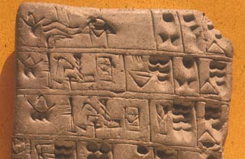
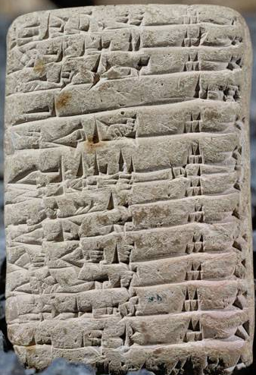
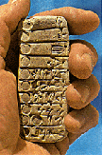
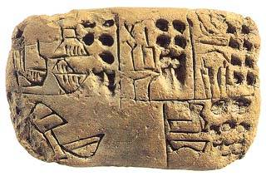
Cuneiform: “Wedge-Shaped” Writing

Slide 18
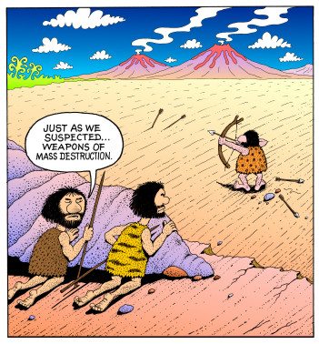
Advanced Technology

Slide 19
Science & Technology (Mesopotamia)
Wheel, plow, sail, bronze
Astronomy, chemistry, knowledge of disease treatment
Arithmetic, geometry
Base 60 (60 sec = 1 minute, 360 degrees)
Architecture influenced civilization
Arches, columns, ramps, pyramid shapes

Slide 20
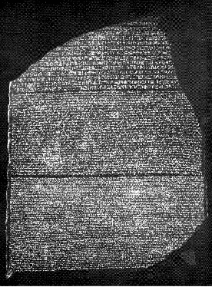
Egyptian Contributions
Architecture: temples, statues, pyramids
Engineering: dams, irrigation canals
Art: metallurgy, stone carving, jewelry
Hieroglyphic writing:
Rosetta Stone
Science: Solar calendar 365 days, 12 months
Geometry (survey floods)
Medicine, surgery, pulse, splints, fever
Embalming
Math, accounting
Notes:
http://touregypt.net/ename/ Hieroglyphics translator!
The name Rosetta refers to the crucial breakthrough in the research regarding Egyptian hieroglyphs. It especially represents the "translation" of "silent" symbols into a living language, which is necessary in order to make the whole content of information of these symbols accessible.
The name Rosetta is attached to the stone of Rosette. This is a compact basalt slab (114x72x28 cm) that was found in July 1799 in the small Egyptian village Rosette (Raschid), which is located in the western delta of the Nile. Today the stone is kept at the British Museum in London. It contains three inscriptions that represent a single text in three different variants of script, a decree of the priests of Memphis in honour of Ptolemaios V. (196 b.c.).
The text appears in form of hieroglyphs (script of the official and religious texts), of Demotic (everyday Egyptian script), and in Greek. The representation of a single text of the three mentioned script variants enabled the French scholar Jean Francois Champollion (1790-1832) in 1822 to basically decipher the hieroglyphs. Furthermore, with the aid of the Coptic language (language of the Christian descendants of the ancient Egyptians), he succeeded to realize the phonetic value of the hieroglyphs. This proved the fact that hieroglyphs do not have only symbolic meaning, but that they also served as a "spoken language".

Slide 21
Indus
Cities laid on precise grid
Sophisticated planning
Fortified citadel
Oven baked bricks of standard size
Plumbing & Sewage systems
Archaeological evidence: stable society, prosperous, little conflict, extensive long-distance trade
Mysterious end
Natural disaster? change of river? land wore out? Attacked?

Slide 22
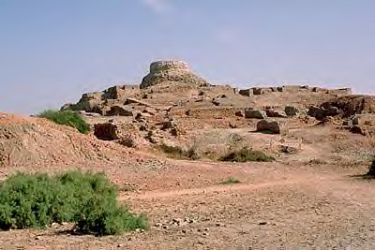
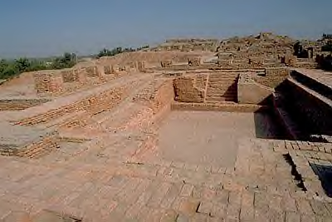
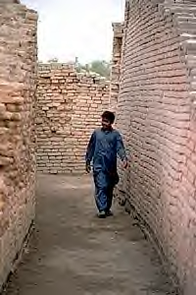
Mohenjo-daro
Public baths
running heated water
Paved roads
Central sewers
Town houses
Notes:
This view shows the high western mound made up of a massive mud brick platform and brick houses of the Harappan period ( 2600 to 1900 B. C.). On top of the Harappan structures is a Buddhist period stupa made of mud brick that dates to the first century A.D.

Slide 23
China
Technology & Trade
Roads & canals stimulated trade & agriculture
Coined money
New class of educated civil servants to run the govt.
Cast iron, IRON AGE, used for weapons & tools

Slide 24
Art/Monument Building
Ziggurat (Mesopotamia)
Pyramid (Egypt)
Mohenjo-daro city (Indus)
Great Wall (China)

Slide 25
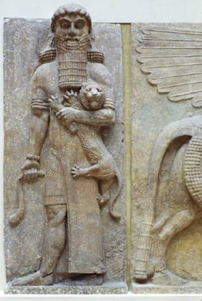
Gilgamesh
Epic of Gilgamesh
– one of earliest works of literature
- Sumerian king’s quest for immortality
- Influenced other ancient cultures (Hebrews, Greeks)

Slide 26
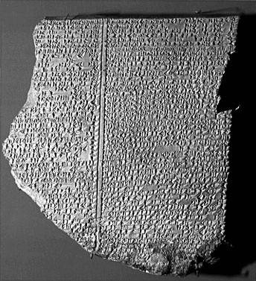
Gilgamesh Epic Tablet: Flood Story

Slide 27
7 Wonder of the Ancient World
Can you name the 7 Wonders of the Ancient World?
Pyramids
Hanging Gardens of Babylon
Statue of Zeus @ Olympia
Temple of Artemis @ Ephesus
Mausoleum at Halicarnassus
Colossus of Rhodes
7. Lighthouse of Alexandria

Slide 28
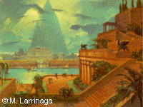
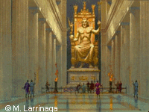
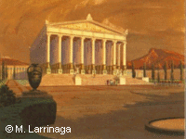
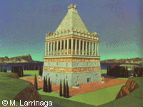
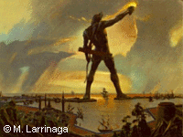
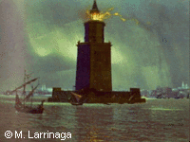
The Other Wonders…
2
3
4
Hanging Gardens
Statue of Zeus
Temple of Artemis
5
6
7
Mausoleum
Colossus
Lighthouse

Slide 29
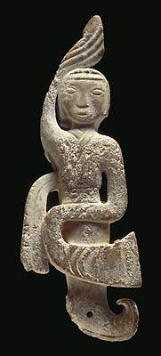
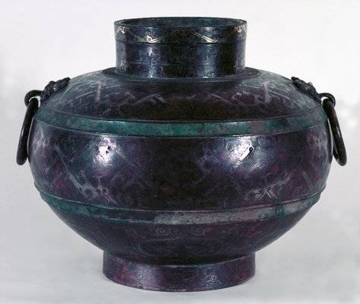
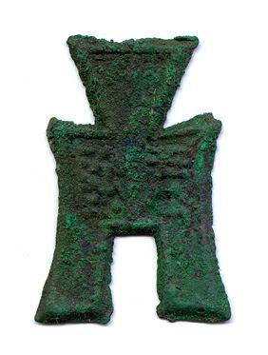
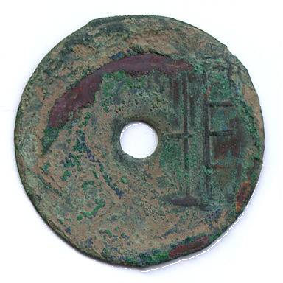
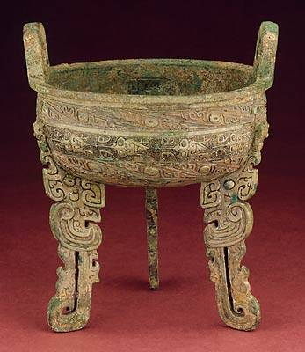
Zhou Coins – Bronze Age

Slide 30
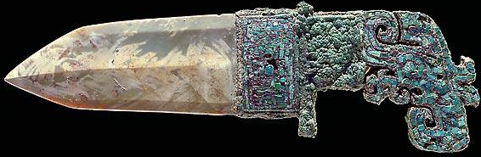
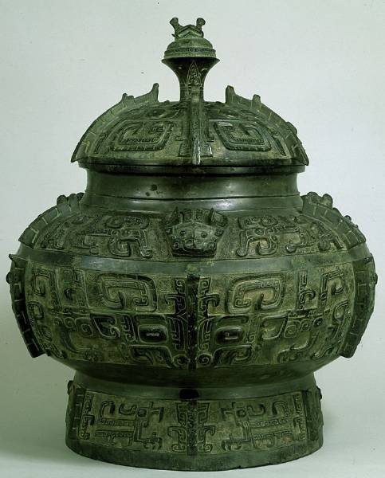
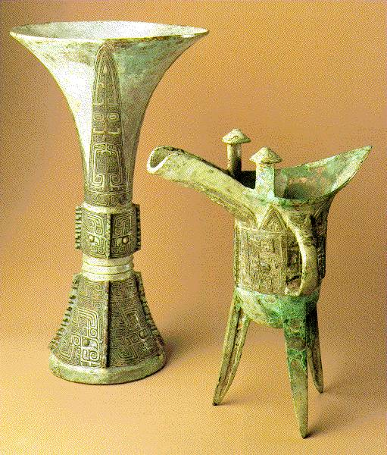

Slide 31
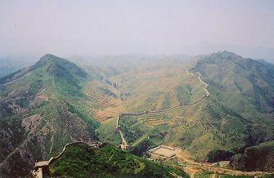
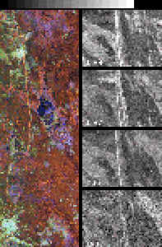
The Great Wall
Built on forced labor
Work or Die
Can be seen from space
Effective barrier to keep out invaders

Slide 32
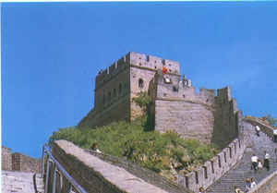
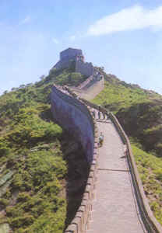

Slide 33
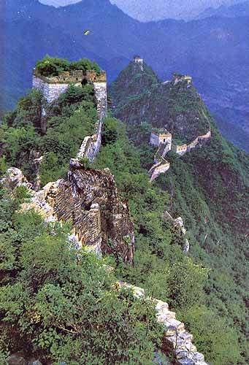
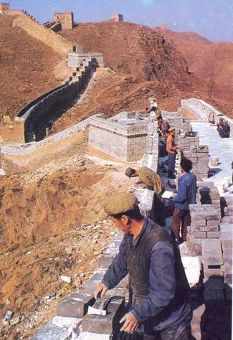
The Great Wall with Towers
Notes:
How effective do you think this kind of fortification would have been in pre-modern times?

Slide 34
Hammurabi’s Code
Single code of laws to unify the diverse people of the empire
Engraved in stone & placed throughout the empire
282 specific laws
Sharp division of classes in punishment
Rigorous system of justice “eye for an eye”
Fair treatment of women

Slide 35
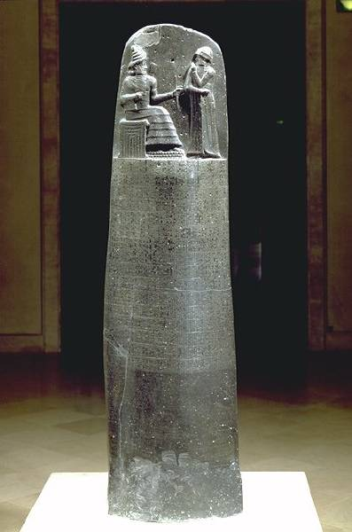
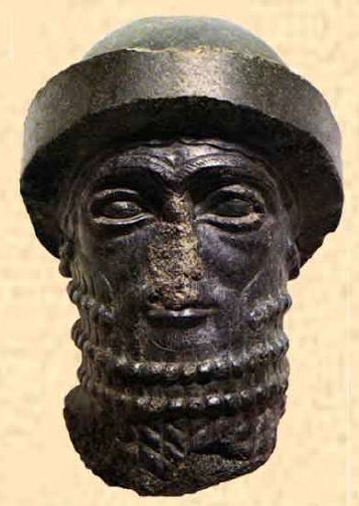
Hammurabi’s Code

Slide 36
Hammurabi’s Code
When Marduk sent me to rule over men, to give the protection of right to the land, I did right and righteousness in ..., and brought about the well-being of the oppressed.
The Code of Laws
1. If any one ensnare another, putting a ban upon him, but he can not prove it, then he that ensnared him shall be put
to death.
2. If any one bring an accusation against a man, and the accused go to the river and leap into the river, if he sink in
the river his accuser shall take possession of his house. But if the river prove that the accused is not guilty, and he
escape unhurt, then he who had brought the accusation shall be put to death, while he who leaped into the river shall
take possession of the house that had belonged to his accuser.
3. If any one bring an accusation of any crime before the elders, and does not prove what he has charged, he shall, if
it be a capital offense charged, be put to death.
4. If he satisfy the elders to impose a fine of grain or money, he shall receive the fine that the action produces.
5. If a judge try a case, reach a decision, and present his judgment in writing; if later error shall appear in his
decision, and it be through his own fault, then he shall pay twelve times the fine set by him in the case, and he shall
be publicly removed from the judge's bench, and never again shall he sit there to render judgment.
6. If any one steal the property of a temple or of the court, he shall be put to death, and also the one who receives
the stolen thing from him shall be put to death.
7. If any one buy from the son or the slave of another man, without witnesses or a contract, silver or gold, a male or
female slave, an ox or a sheep, an ass or anything, or if he take it in charge, he is considered a thief and shall be put
to death (of 282)
Why is a posted legal code innovative?
How did Hammurabi know that his code
would be known by those traveling in his
kingdom?
Why would westerners later consider this to
be a foundation document of democracy?

