Slide 1
Professional Night 2016
The Legacy and Pilot DBQs

Slide 2
The “Revised” DBQ Greg Ahlquist, Test Development Committee
Agenda
Overview of the Revised Exam Format.
DBQ Shifts from Legacy to Revised.

Slide 3
Features of Exam | Current Exam | Revised Exam Format
Multiple-Choice Section | 70 questions | 55 questions
 | 55 minutes | 55 minutes
 | 50% weight | 40% weight
Short Answer | none | 4 question sets
 |  | 50 minutes
 |  | 20% weight
DBQ | Up to 10 documents Bringing in “outside” knowledge beyond documents is one of several ways to earn points in expanded core | 7 documents Requires bringing in “additional evidence’ beyond documents
 | 50 minutes (including 10 minute reading period) | 55 minutes (including reading period)
 | 16.7% weight | 25% weight
Long Essay(s) | One CCOT question One Comparison question | Students select one of two questions; both questions are same skill (Comp, CCOT, Causation, or Periodization)
 | 40 minutes each | 35 minutes
 | 16.7% weight each | 15% weight

Slide 4
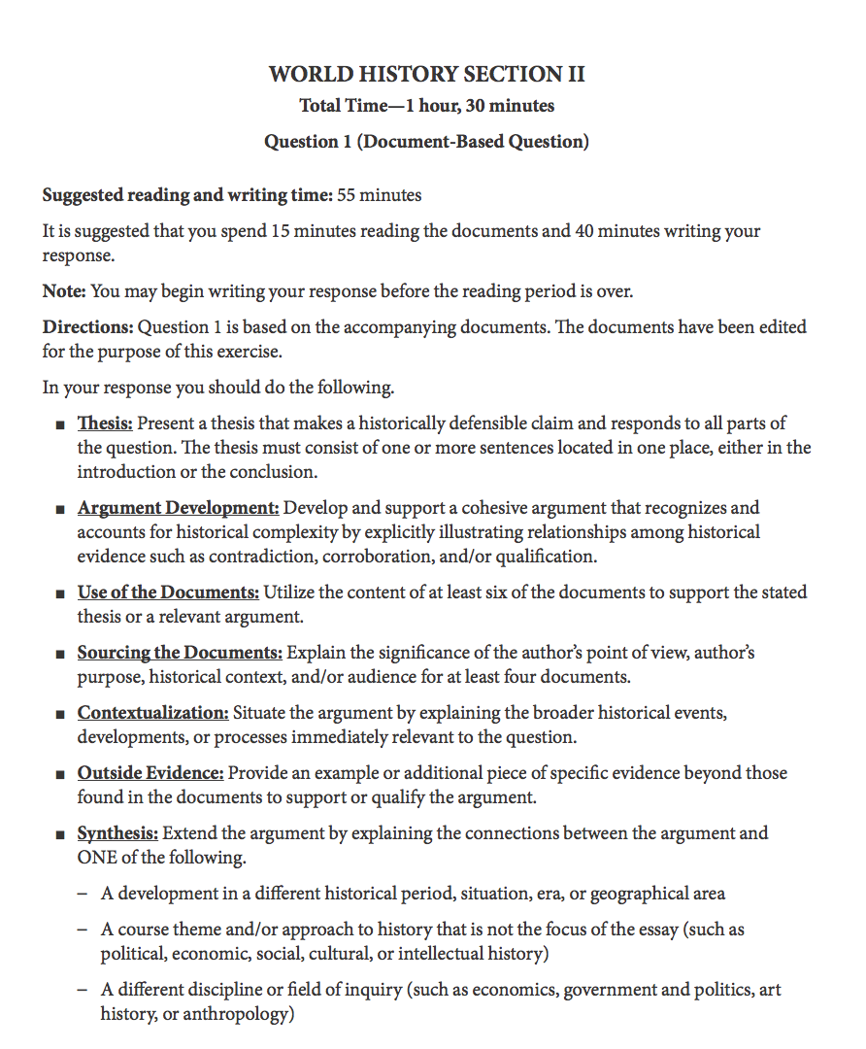
NOTE: All 7
Rubric Points
are identified
and explained
for students

Slide 5
5 SHIFTS in DBQ Design

Slide 6
Shift #1: 7 Documents
At least one document will be a visual (chart, graph, map, art, etc.).

Slide 7
Shift #2: Additional Evidence
Teaching the content in the Curriculum Framework will provide students with the knowledge to earn the additional evidence point.

Slide 8
Shift #3: Thesis responds to ALL parts of the prompt
Prompt language specificity.
Example:
-“Analyze changes and continuities in…”
-“Analyze at least one change and at least one continuity in…”

Slide 9
Shift #4: Synthesis
Student needs to connect or expand the argument to a different time, space, theme, or discipline.

Slide 10
Shift #5: Sourcing the Docs
Student must source (historical context, intended audience, purpose, point of view) at least 4 docs

Slide 11
“Utilize the Documents” continues from Legacy DBQ
“Understanding” and “Evidence” = Legacy
“Utilize the Documents” awards no points for basic “Understanding”
Must be in support of a historical claim

Slide 12
Contextualization
-Situates the argument in wider Historical Context

Slide 13
5 Design Shifts for Revised DBQ
7 Documents.
Additional Evidence.
Thesis responds to ALL parts of question.
Synthesis—expand/connect argument.
Sourcing at least 4 docs.

Slide 14
The Pilot DBQ Anton Striegl
Agenda
Introduce/overview the pilot DBQ.
Scoring guidelines and scoring.
Strategies for teaching the new DBQ.
Methods for converting old DBQs to the new format.
* We will have to stay on a schedule to reach all of these worthwhile topics.

Slide 15
History & Focus of 2016 Pilot
Piloted in 2015
Practiced entire scoring process: trained teachers, standardized…
Generated specific rubrics and samples
Learned a great deal
Revisions occurred in Summer and Fall in meetings with all 3 histories
U.S., Euro, and World all using same rubrics
2015 samples were re-scored w/revised rubrics
That work was released as a Practice Exam in March, 2016
2016 Pilot
Larger sample, same DBQ
Students received some focused training on rubrics before writing (results a little more reflective 2017 expectations)
Building experience and refining our understanding for 2017

Slide 16
The Pilot DBQ
Prompt:
Using the documents provided and your knowledge of World History, analyze the degree to which communist movements affected women’s struggle for rights in the twentieth century.

Slide 17
The Documents
Take 5 minutes to read the 7 documents.

Slide 18
Quick Overview of the Documents
Not enough time to discuss each document at length.
Getting a baseline understanding.
Want to get to samples and strategies.

Slide 19
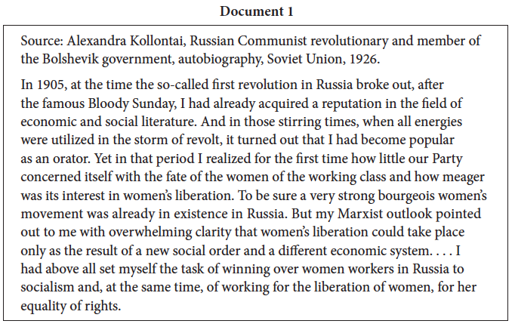

Slide 20
Doc 1: Alexandra Kollontai Russian Communist revolutionary and member of the Bolshevik government, autobiography, Soviet Union, 1926.
Marxism will bring women’s liberation
Author noticed a lack of concern for women’s rights in 1905 among Bolsheviks
Author dismisses efforts of Russia’s “bourgeois” women
Author helped achieve improvements for women under Bolsheviks

Slide 21
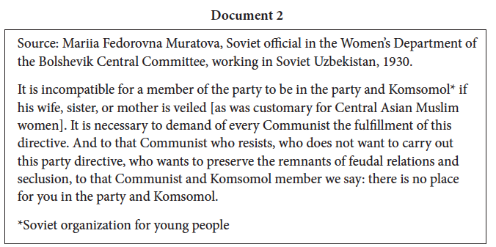

Slide 22
Doc 2: Mariia Fedorovna Muratova, Soviet official in the Women’s Department of the Bolshevik Central Committee, working in Soviet Uzbekistan, 1930.
Soviet communism seeking to end veiling in Uzbekistan among party members
Veiling seen as remnant of feudal past
Directive for party members to end veiling in their families

Slide 23
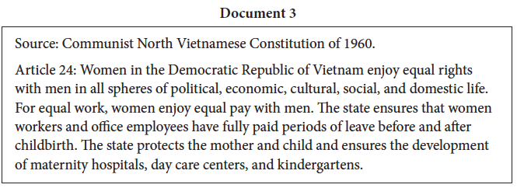

Slide 24
Doc 3: Communist North Vietnamese Constitution of 1960.
Communist North Vietnam promising full equality for women
Constitution declares:
Equal pay
Paid maternity leave
Access to maternity care, child-care, and education

Slide 25
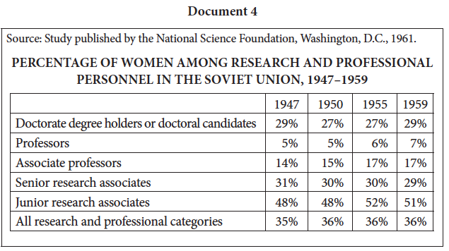

Slide 26
Doc 4: Study published by the National Science Foundation, Washington, D.C. 1961.
Majority of data shows women not equal to men in USSR
PHD’s
Professors
Associate Professors
Senior Researchers
Women close to parity in Junior Research category

Slide 27
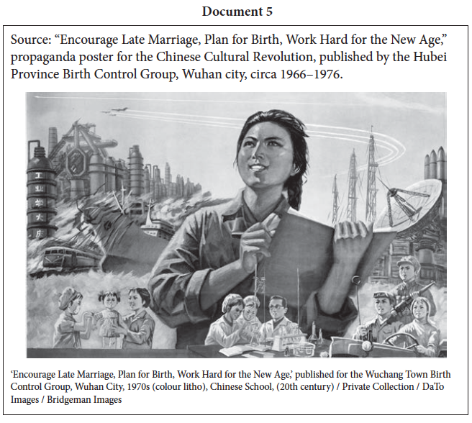

Slide 28
Doc 5: “Encourage Late Marriage, Plan for Birth, Work Hard for the New Age,” propaganda poster for the Chinese Cultural Revolution, published by the Hubei Province Birth Control Group, Wuhan city, circa 1966-1976.
Chinese communism provides women opportunities in key, high-tech jobs
Women are needed to help China modernize
Poster promotes delaying child birth so women can join labor force

Slide 30
Doc 6: Fidel Castro, president of Cuba, speech to Federation of Cuban Women, 1974.
Castro admits that women didn’t attain equality in communist Cuba
Women have high communist credentials
Never overcame patriarchy
Castro promises to continue the struggle

Slide 31
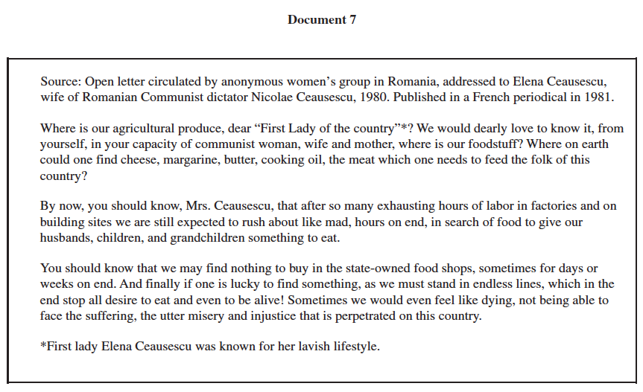

Slide 32
Doc 7: Open letter circulated by anonymous women’s group in Romania, addressed to Elena Ceausescu, wife of Romanian Communist Dictator Nicolae Ceausescu, 1980. Published in a French periodical in 1981.
Most women suffer in Communist Romania
Women did get factory jobs, but:
But food shortages hurt women and families
Women were stuck doing domestic work after long days in factories
Wives of party officials live rich lives

Slide 33
Scoring Guide 2016 Pilot DBQ
See scoring guide in packet*
Seven point DBQ (Parts A, B, C, D)
No basic/expanded core
Each point earned independently
No double-jeopardy
Unique evidence required for each point
No double-dipping

Slide 34
A. Thesis
Key Terminology
“Historically defensible claim”
Responds to all parts

Slide 35
Thesis Example that Works:
“Communism furthered the struggle for women’s equality in the 20th century, but not as much as it said it did as shown by how women fought for their own rights, how others fought and viewed women’s rights, and how women were equal in theory, but not in actuality.”

Slide 36
Thesis Non-Example:
One that doesn’t work:
“Women in some of these countries (Vietnam and China) were given rights, but in most countries they continued to be held back from gaining power (USSR, Cuba, Romania).”
Not related to communism

Slide 37
A. ARGUMENT DEVELOPMENT
Key language:
Develops & supports a cohesive argument
Recognizes and accounts for historical complexity
Contradiction, corroboration, qualification
Rewards a student that develops and supports a cohesive/complex argument throughout the essay
Earned independently (not “expanded core”)

Slide 38
Argument Development MODEL:
INTRO with competent THESIS
Body 1: Communism promotes equality for women
Discusses docs 1, 2, 3 CORROBORATION
Body 2: Reality did not match the promise
Discusses docs 4, 5, 6, 7 CONTRADICTION / QUALIFICATION
Evidence in body paragraphs also supports argument
Could still be earned without thesis (must have an argument)
Argument must be complex

Slide 39
Argument Development non-Example:
THESIS: Communism effected women’s rights in political, social, and economic ways
TOPIC SENTENCE: The political ways…
TOPIC SENTENCE: The social ways…
TOPIC SENTENCE: The economic ways…
Simple structure is not enough!

Slide 40
B. Utilizing Docs as Evidence
DBQs will have 7 documents
Higher bar than simply accurately interpreting a document
Must utilize or “DEPLOY” 6 documents to support an assertion/arguments
“Utilizes” is the old “Evidence” level (no more “understands” level)

Slide 41
Utilizing Documents: Example 1
Doc 1: Kollontai “noticed how little her party cared about the fate of working-class women”

Slide 42
Utilizing Documents: Example 2
Doc 2: “ A female Soviet official explains that the Central Asian Muslim tradition of wearing veils opposes the fundamentals of the Communist Party… this shows how communist ideals supported equality.”

Slide 43
Utilizing Documents: Example 3
“In doc 5, a propaganda poster from communist China shows many women pursing countless professional fields. This shows that Communist movements supported the advancement of women’s roles.”

Slide 44
Example of Unacceptable Utilization
“Document 5 shows the communist government of China promoting a lot of industrial growth. The images show growth in many high-tech industries, such as manufacturing, aerospace, medicine, and science.”
Not related to women’s rights

Slide 45
B. Sourcing/POV
Must source 4 documents
Four ways to do this: Explain the significance of:
Author’s point of view
Author’s purpose
Historical context (new - “Little c” context)
Intended audience

Slide 46
Sourcing by POV
Must explain the SIGNIFICANCE of the author’s point of view
Must explain how the author’s point of view shapes or informs the content of the document

Slide 47
Sourcing: Successful Example - POV:
(Document 3)
“In the North Vietnamese Constitution, it not only claims democracy, but claims women have complete equality to men, which they did not. It is a government document, so obviously it would glorify Vietnam as a country flooding with equality…”

Slide 48
Sourcing: Non-Example - POV
“The author of document 2 is a government official who cares about women’s rights but many other people in her party didn’t.”
Does NOT explain how being a government official shapes or informs what is said in the doc.

Slide 49
Sourcing by Purpose
Must explain the SIGNIFICANCE of the author’s purpose
Must explain how the author’s purpose shapes or informs the content of the document

Slide 50
Sourcing by Audience
Must explain the SIGNIFICANCE of the audience
Must explain how the audience shapes or informs the content of the document

Slide 51
Sourcing Example: Audience/Purpose
“Document 6 is Cuban communist leader, Fidel Castro, speaking to a women’s organization. It is likely that he is trying to persuade more women to join the communist party.”
“The Chinese propaganda poster in doc 5 supports advancement of women… This poster, made to gather support for the communist revolution, was published to appeal to the wants and needs of women.”

Slide 52
Sourcing by Historical Context
Must explain the SIGNIFICANCE of the historical context
Must explain how the context (contemporaneous developments not described in the document) shapes or informs the content of the document
Uses context to situate one document
Called “little c” context

Slide 53
Sourcing Example: Context (1)
“In doc 3, …This shows that a communist government officially legislated the equality of women. This would have been something like a slap in the face to the USA who fought to limit the spread of communism in Vietnam, only to fail and see them enforce feminist laws that the U.S. had not.”

Slide 54
Sourcing Example: Context (2)
Doc 4: “While likely accurate, coming from a US source raises the question of its legitimacy, as the US was locked in the Cold War with the USSR, and may have simply wanted to rally the American people against the Soviet Union.”

Slide 55
Sourcing by context: Non-Example
Simply mentioning a piece of context without explaining the significance to the topic is unacceptable.
“Doc 4, written during the Cold War, shows that women in Russia were not equal to men, especially in top jobs.”

Slide 56
Part C: Contextualization
“Big C” contextualization situates the thesis, argument, or parts of the argument to broader events, developments, or processes
Best situated in intro or conclusion to differentiate from sourcing (“little c”) context
Must be immediately relevant and well explained

Slide 57
“Big C” Context
Industrialization
Marxist Ideology
The Cold War
Enlightenment Ideology
Global Feminism
Communism and Women’s Rights
Making connections to and from global processes
SITUATING the topic of the essay or the argument, into a larger flow of historical events

Slide 58
Examples of possible events, developments, or processes for contextualization
Marxist ideology, specifically relating to class struggle, stages of historical development, need to radically reform society, inevitability of progress to communism, etc.
Soviet and other communist countries’ economic and social policies, including collectivization, nationalization, rapid industrialization, economic planning, drastic expansion of educational opportunities, expanding social welfare, guaranteeing employment, etc.
NOTE: To earn the point, these examples must be accurately and explicitly connected to the effects of communism on women’s rights, beyond a mere mention.

Slide 59
Examples of possible events, developments, or processes for contextualization (p2)
Communist policies of suppressing dissent and projecting a vision of a unified society, specifically through the use of propaganda.
The Cold War, the establishment of communist governments in Eastern European countries, and the spread of Communist governments or communist movements in Asian, or Latin American countries, often in the context of proxy conflicts with the United States.
NOTE: To earn the point, these examples must be accurately and explicitly connected to the effects of communism on women’s rights, beyond a mere mention.

Slide 60
Examples of possible events, developments, or processes for contextualization (p3)
The economic stagnation and decline experienced by most communist countries in the latter decades of the 20th century (The events surrounding the fall of communism in the late 1980s, while chronologically later than the documents, can be used successfully to earn the contextualization point, provided they are explicitly connected to the topic of women’s rights.)
NOTE: To earn the point, these examples must be accurately and explicitly connected to the effects of communism on women’s rights, beyond a mere mention.

Slide 61
Contextualization “Big C” Example 1 in Intro
“Women’s rights have been a struggle that many females tried to achieve ever since the early beginnings of industrialization. The unfair divide industrialization caused led to a mass usage of Enlightenment or socialist ideals which in some ways supported women’s rights. THESIS …………….”

Slide 62
Contextualization “Big C” Example 2
“While women struggled for freedom throughout the western world, communist revolutions were radically equalizing for females, helping the suffragettes everywhere.”

Slide 63
Contextualization “Big C”: Non-Example
“In the 20th century, the two world wars gripped the world with bloodshed and fear. Between the wars, the Great Depression saw the world experience the greatest economic collapse in history. These events led many to look to socialism and communist movements as a way to create a better world.”
CONTEXT NOT IMMEDIATELY CONNECTED TO WOMEN’S RIGHTS

Slide 64
Contextualization “Big C” Non-Example (2)
“During the 20th century, communism was becoming widespread. Because of Marxist ideas, communist movements affected women’s struggle for rights.”
NOT SPECIFIC

Slide 65
C. Evidence Beyond the Docs
Provides an additional example or evidence of an effect of communism on women’s rights.
Must be explained in a way that further supports or extends the argument.
Simply mentioning a fact that occurred simultaneously to the topic, without explaining the connection, is not enough.

Slide 66
Evidence Beyond the Docs: Positive Example 1
“An example of communist inspiration to their women was the putting of the first woman in space by the USSR, which must have inspired women nationwide.”

Slide 67
Evidence Beyond the Docs: Positive Example 2
“The documents don’t address how radically different the communist lifestyle is such as how the CCP promotes marrying late and planning families which differs from the Confucian emphasis on families.”

Slide 68
Evidence Beyond the Docs: Positive Example 3
“One piece of historical evidence that further helps this topic is that Mao Zedong, a communist leader in China, made a speech directly stating that ‘Women hold up half the sky,’ and made various laws according to that statement to make women more equal to men.”

Slide 69
Additional Evidence: Non-Example
“The Chinese communist government also created propaganda posters to persuade women to become nurses.”
Document 5 already established that communism brought new job opportunities for women. Another iteration of something already in the documents is not acceptable.

Slide 70
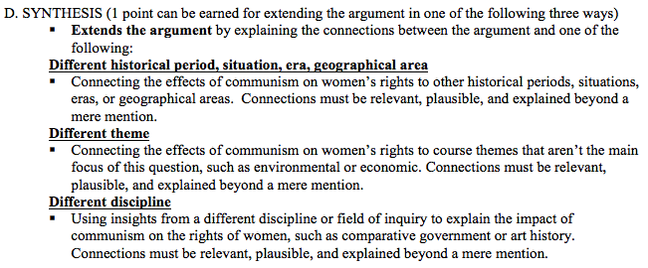
D. Synthesis: 1 point, 3 ways to earn
Must EXTEND THE ARGUMENT by considering another:
Geographic area, historical era, situation, theme or discipline
Connection must be relevant, plausible, and explained beyond a mere mention.

Slide 71
Synthesis
A consideration or comparison
that extends the argument
Effect of
Communism on
Women’s Rights
Outside place, era, theme,
or discipline
Valid comparison or connection that
extends argument

Slide 72
Positive Synthesis Example 1 (different region):
Found in conclusion
“Women fought for their freedom and equality in all aspects of communist society. But, not all communist societies were able to achieve this goal. Also during the 20th century, women in the United States fought for their liberation from patriarchal society, however they did so through protests and civil rights movements, not solely government activity.”

Slide 73
Rationale Example 1
Extends argument by comparison to a different geographic region beyond the documents.
Compares strategies for gender equality, noting difference between experiences in the USSR (government driven reform) and the U.S. (democratic processes/protests)

Slide 74
Positive Synthesis Example 2 (different region):
“The North Vietnam Constitution in Doc 3 also proves the Communist intention for equal working rights as ‘women enjoy equal pay with men.’ Although we still should question if women actually did, as laws aren’t always followed, seen even today as modern countries such as the USA where gender discrimination is outlawed, but a wage gap still exists.”

Slide 75
Rationale Example 2
Extends argument by comparison to a different geographic region and historical period beyond the documents.
Compares legal promise of equal rights in North Vietnam to that of the United States.
Finds similarity in failed promises.

Slide 76
Positive Synthesis Example 3 (different region):
Found at end of a body paragraph about Communist governments enacting rapid change for women
Doc 1 – Russian women helped by party after the revolution
Doc 2 - Communists eliminating veil in name of equality
Doc 3 - Vietnam granting equality in constitution
“We can compare these ideas to another part of the world, in the United States. But with the women’s suffrage rights movement in the U.S., many women activists as well as the government came together to change the laws and help women with equal rights.”

Slide 77
Rationale Example 3
Extends argument by comparison to a different geographic region beyond the documents.
Finds difference in that both activists and government officials created positive change in the U.S., compared to government driven change in communist states.

Slide 78
FAILED Synthesis Example 4 (different region):
FAILED synthesis in conclusion:
“In the 20th century, women were faced with many issues regarding little rights in the communist society. The story seems quite similar to the patriarchal/strict society of Islam during the early modern era.”
Connection with outside region is not explained

Slide 79
Synthesis Examples (different themes):
One that works:
DBQ is POLITICAL and SOCIAL
Possible connections to ECONOMIC
Soviet-style economics and centrally-planned economy
Having women in the workforce was essential to meeting the economic objective of the Soviet state
Communist unwavering emphasis on heavy industry and macroeconomic projects, may have pointed out that producing consumer goods was seen as low priority, resulting in chronic shortages and deficits of food items and other basic needs. These shortages placed an especially heavy burden on women and undermined the rhetoric of emancipation.

Slide 80
Synthesis Examples (different discipline):
Comparative government and politics
Communist political systems pretended to have a democratic system, while in reality the one single communist party was controlling everything. Elections happened, but they didn’t decide much, as only the candidates approved by the party could win. One could be sent to prison or worse if one protested his or her conditions too openly. Thus we should question how much it means to have laws or constitutions give equality to women, if the state and the party could change any policy they wanted.

Slide 81
Summary of Changes
What is GONE?
“Understands” level of document usage
Additional document
Grouping as an explicit rubric point
Basic/Expanded Core
What is ADDED?
Argument Development
Sourcing at least 4 docs and “context” as way to do it
Contextualizing the topic or argument
Evidence Beyond the Documents
Synthesis

Slide 82
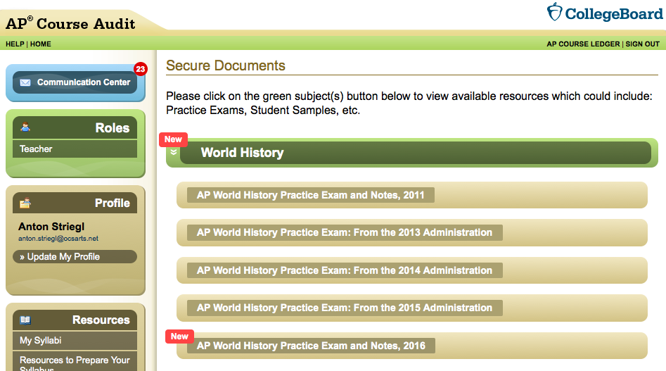
Practice Exam on AP Central
Released in March on AP Audit website.

Slide 83
New DBQ – Strategies 8:15 - 8:45 Monica and Anton
All skills will overlap. So working on DBQs will help with other essays (thesis and argument) and Multiple Choice Questions (MCQs) and Short-Answer Questions (SAQs)
Introduce skills individually with their own component parts, this makes grading easier to identify problem areas
Depending on your students you might start with MCQs, then SAQs and then parts of DBQs

Slide 84
Build on Previous Practice
Thesis – still will be the challenge for our students. Short-Answer Questions might help them with this
Utilizing – like Supporting Thesis with Evidence
Can’t simply quote, summarize or paraphrase without explicitly addressing the prompt/thesis.
SAQs with stimulus will help with this too.
Encourage your students to address all as there is always a chance that they might not get all 6 of the others them right

Slide 85
Similar But Different
Argument Development – some grouping might help them here but can’t be all these are from Africa sort of group, needs to be more sophisticated
Topic sentences (mini-thesis) are key here
Shoe lesson won’t work. Instead try Larry Treadwell’s old football DBQ and have kids “group” them according to all three of these categories – contradiction, corroboration, and qualification etc.

Slide 86
Similar But Different
Sourcing – like POV; for those who used SOAPSTONE, now SOAP; Practice with each
POV = Speaker
Historical Context = Occasion on Steroids
Audience
Purpose
Can’t simply restate material in source line, need to make connection to its significance
Considerable overlap – e.g. students addressing audience will often also address purpose, etc.
Have kids attempt more than 4 as insurance

Slide 87
New to APWH - Contextualizing
Build on Global Context for CCOT
Teach concept of zooming in/focusing on the topic, then widen the lens to the society, region, world, time period and the event/developments/processes.
Emphasize tying it back to the prompt!!!

Slide 88
New to APWH - Contextualizing
Have kids start with themselves on a test day and understand the factors affecting their performance
How much they slept, studied, etc.
How teacher prepared them; classmates’ influences
School resources (e.g. textbook), principal’s priorities
County/school board’s goals, real estate/taxes, parents’ education level and expectations
State’s department of education’s testing policy, subsidizing of exams, training of teachers, etc.
National – rankings, focus on world history

Slide 89
New to APWH – Outside Evidence
NOT like Additional Document
Think of Geography - societies related to topic
Argument Development - see if there is evidence that would help either corroborate, contradict or qualify points made by documents (this would also help students place it within their essays)
Give MCQs asking which piece of evidence would help support / contradict / qualify argument given

Slide 90
New to APWH - Synthesis
Un-teach other teachers’ teachings like we do w/comparison
Introduce first in MCQs & SAQs before having them do this in
Hammers home point of argument development as this MUST TIE TO PROMPT!!!!

Slide 91
New to APWH - Synthesis
Different period, situation, era, area – not just what we did in CCOT but rather a comparison that leads to analytical realization
e.g. Lin-Manuel Miranda looking at Alexander Hamilton and seeing similarities to Rap Artists → Hamilton the hip-hop musical

Slide 92
New to APWH - Synthesis
Different Theme
MUST HAMMER SPICE INTO THEIR HEADS
e.g. Czech women wanting to wear jeans and listen to rock and roll but deemed un-communist
Social = people vis a vis other people: class, gender, race
Political = they usually get this one: government, military, laws
Interactions with Environment: climate, natural disasters, demography, migrations (don’t forget the humans!)
Cultural = people can do on their own: religion, art, music, food, fashion
Economic – usually get it – trade, industry, labor

Slide 93
New to APWH - Synthesis
Different Discipline – we do this all the time in class, need to be explicit about it – art history, archeology, anthropology/sociology, epidemiology, economics

Slide 94
What to do with Old DBQs
Take documents & use as stimulus for MCQs
Good way to start - teach closer reading before jumping into DBQs
Good way to practice tough skills like historiography, contextualization, outside evidence
Take documents & use as stimulus for SAQs
Good way to introduce writing skills
Mini- thesis
Contextualization
Argument development
Modify into new format

Slide 95
Out with the Old, in with the New? Modifying Legacy DBQs Greg Ahlquist
2010 AP World History Exam DBQ
Using the following documents, analyze similarities and differences in the mechanization of the cotton industry in Japan and India in the period from the 1880s to the 1930s.
10 Documents

Slide 96
5 Design Shifts for Revised DBQ
7 Documents.
Additional Evidence.
Thesis responds to ALL parts of question.
Synthesis—expand/connect argument.
Sourcing at least 4 docs.

Slide 97
Shift #1: 7 Documents
-Out of 10 documents, 5 docs were CHARTS or PHOTOS
-I decided to keep the PHOTOS
-I cut 3 out of 4 CHARTS
-I cut Doc 4 (Japanese Buddhist priest) to keep India/Japan balance

Slide 98
Shift #2 and #3: Outside Evidence and Prompt Specficity
Legacy Prompt:
Using the following documents, analyze similarities and differences in the mechanization of the cotton industry in Japan and India in the period from the 1880s to the 1930s.
Revised Prompt:
Using the documents provided and your knowledge of World History, analyze at least one similarity and at least one difference in the industrialization of cotton goods in Japan and India in the period from the 1880s to the 1930s.

Slide 99
Revised Prompt
Using the documents provided and your knowledge of World History, analyze at least one similarity and at least one difference in the industrialization of cotton goods in Japan and India in the period from the 1880s to the 1930s.

Slide 100
Pressure Testing the DBQ
OUTSIDE EVIDENCE
CONTEXTUALIZATION
SYNTHESIS
Compare to British Textile production / Meiji
Imperialism / Global competition / Interactions with the West
Connect to different
TIME: Indian textiles in Period 3 (3.3 I B)
PLACE: Russia Industry (5.1 I D)
THEME: Political

Slide 101
The Documents
I used Docs 1, 3, 5, 6, 8, 9, 10 (cut 2, 4, 7)
Source Lines worked well – no additions

Slide 102
The End

